Slide 1
Inheritance
CS 1501 Metaprogramming
Maxwell Patek
(mtp4be)

Slide 2
Today: Python Inheritance
Review
Watch Prisoners
The Syntax
Some examples
A Method Resolution Order (MRO)
Multple Inheritance
The Diamond Problem
C3 Linearization
The Method Resolution Order (MRO)
Super()

Slide 3
Review
Objects are everywhere in Python
Python is dynamically typed
Use assertions and warning to counteract
Make your own types of objects with “class”
methods must take “self” as first parameter!
__init__ is the constructor
”dunder” means “__” means built-in method
str() calls __str__()
__new__ is static
makes self
__init__ is non-static
populates self

Slide 4
Let’s Watch Our Prisoners

Slide 5
Syntax:
Superclass(s) go here
“is a …”
>>> class Person:
... def __init__(self, name):
... self.name = name
... def __str__(self):
... return "I'm "+self.name
...
>>> print(Person('Max'))
I'm Max
>>> class Student(Person):
... def __init__(self, name, id):
... self.id = id
... super().__init__(name)
... def report(self):
... return self.id
>>> print(Student('Max', 'mtp4be'))
I'm Max
>>> print(Student('Max', 'mtp4be').report())
mtp4be
>>> class Person(object):
...
>>> class Student(Person):
... def __init__(self, name, id):
... self.id = id
... Person.__init__(self, name)
Can also explicitly inherit from object
Use super() to access the superclass
(kind of)
Or explicitly reference the superclass you want
(note: you need self here)
Notes:
Be more direct with the super() forshadowing. Mention that directly referencing superclass is discouraged... just use super.

Slide 6
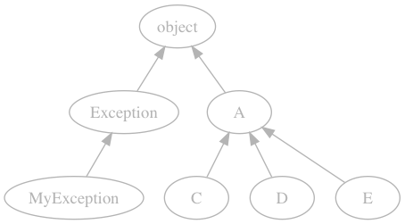
Let’s Implement a Diagram

Slide 7
Let’s Implement a Diagram
>>> class A(object):
... pass
...
>>> class C(A):
... pass
...
>>> class D(A):
... pass
...
>>> class E(A):
... pass
...
>>> C.__bases__ # as in baseclasses
(<class '__main__.A'>,)
Notes:
add slide with digram before
add explanation/arrow for why "bases." Color the A. "List of parents"
highlight part of diagram that us relevent

Slide 8
Let’s Implement a Diagram
>>> class MyException(Exception):
... def __init__(self, msg):
... super().__init__(msg)
... print('One Exceptional Exception!')
...
>>> raise MyException('test')
One Exceptional Exception!
Traceback (most recent call last):
File "<stdin>", line 1, in <module>
__main__.MyException: test
Notes:
Subclass some other builting

Slide 9
The Method Resolution Order (MRO)
Suppose we call c.foo()
We need to find a definition of foo() to call
Where do we look first?
C
Then,
A
object
So the MRO is “search up from the type of the object.”
Here, [C, A, object]
This works because it’s a tree.

Slide 10
You May Have Noticed…
that I said “superclass(es)”
that super() usually means superclass
“Class.__bases__”
Which brings us to…
Notes:
typo on superclassss

Slide 11
Multiple Inheritance

Slide 12
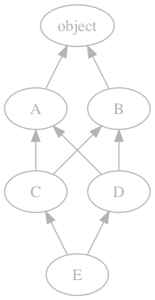
Let’s Just Try It
>>> class A(object):
... pass
>>> class B(object):
... pass
>>> class C(A, B):
... pass
>>> class D(B, A): # note
... pass
>>> class E(C, D):
... pass
>>> E.__bases__
(<class '__main__.C’>, <class '__main__.D'>)
Notes:
extra parentheses

Slide 13
The Diamond Problem
Suppose we call e.foo()
We need to find a definition of foo() to call
Where do we look first?
E
Then,
C or D?
we defined E as E(C, D)
lets search in that order
C
A, B, or D?
not clear, we need an algorithm
Notes:
give up after A, B, D

Slide 14
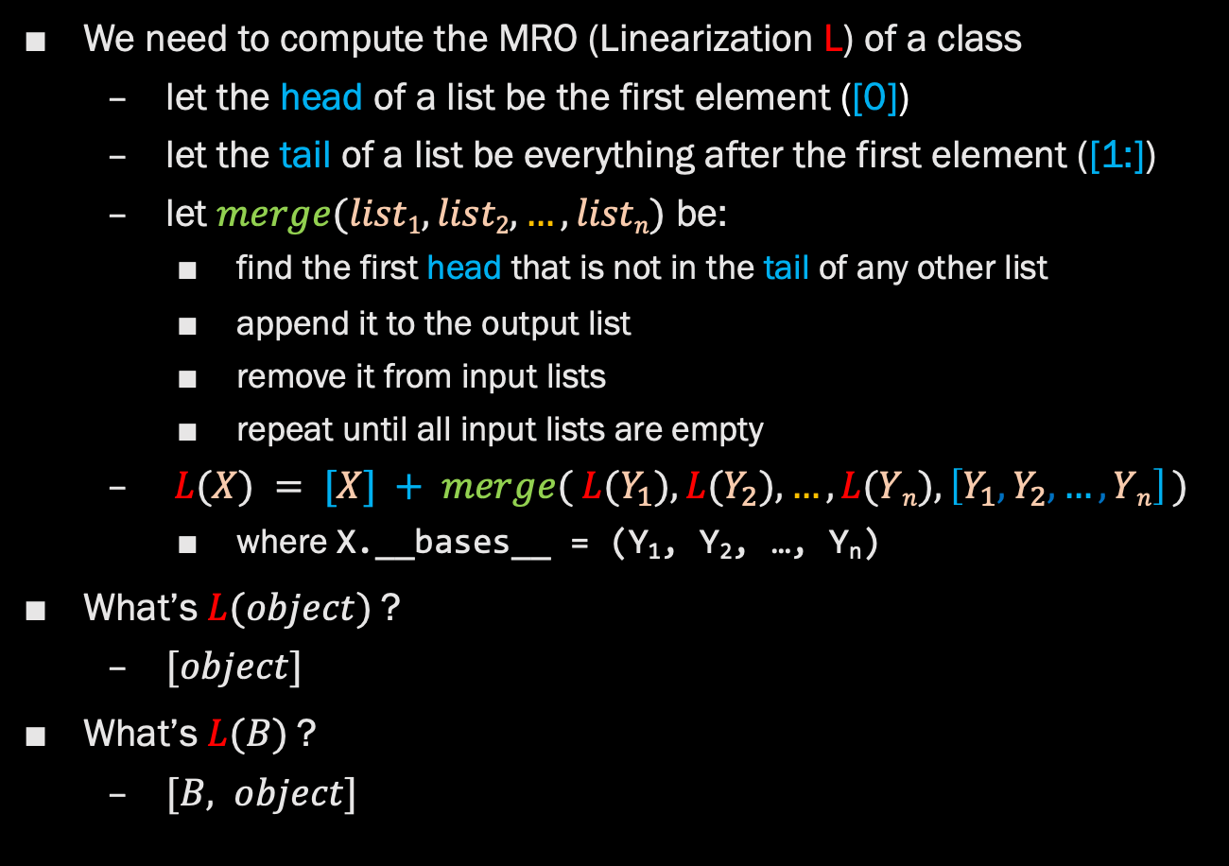
C3 Linearization
We need to compute the MRO (Linearization L) of a class
let the head of a list be the first element ([0])
let the tail of a list be everything after the first element ([1:])
let $merge(list1, list2, …, listn)$ be:
find the first head that is not in the tail of any other list
append it to the output list
remove it from input lists
repeat until all input lists are empty
$L(X) = [X] + merge( L(Y_{1}), L(Y_{2}), …, L(Yn), \left[Y_{1},Y_{2}, …, Yn\right] )$
where X.__bases__ = (Y₁, Y₂, …, Y_{n})
What’s $L(object)$?
$[object]$
What’s $L(B)$?
$[B, object]$

Slide 15
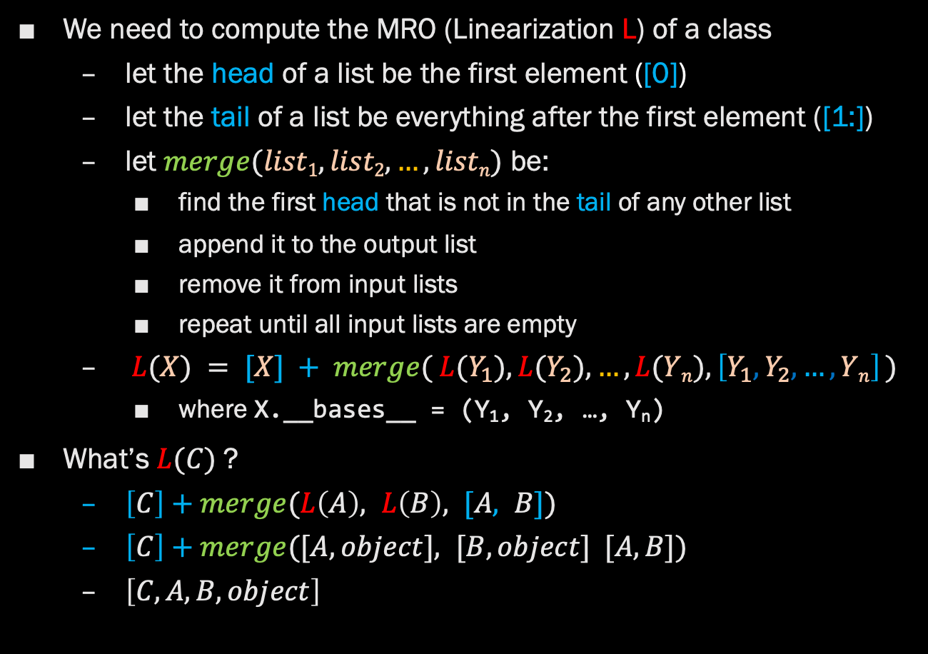
C3 Linearization
We need to compute the MRO (Linearization L) of a class
let the head of a list be the first element ([0])
let the tail of a list be everything after the first element ([1:])
let $merge(list1, list2, …, listn)$ be:
find the first head that is not in the tail of any other list
append it to the output list
remove it from input lists
repeat until all input lists are empty
$L(X) = [X] + merge( L(Y_{1}), L(Y_{2}), …, L(Yn), \left[Y_{1},Y_{2}, …, Yn\right] )$
where X.__bases__ = (Y₁, Y₂, …, Y_{n})
What’s $L(C)$?
$\left[C\right]+merge(L\left(A\right), L\left(B\right), [A, B])$
$\left[C\right]+merge([A, object], [B, object] [A, B])$
$\left[C, A, B, object\right]$

Slide 16
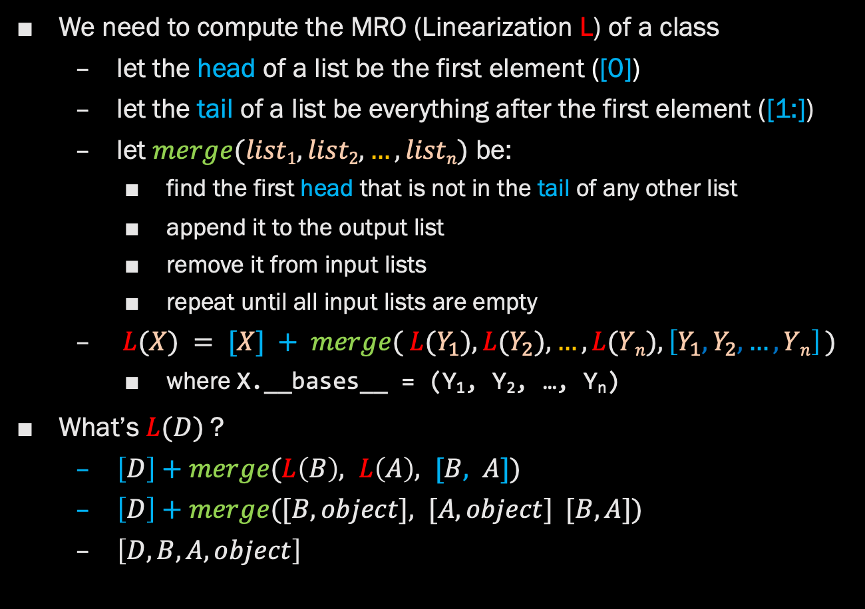
C3 Linearization
We need to compute the MRO (Linearization L) of a class
let the head of a list be the first element ([0])
let the tail of a list be everything after the first element ([1:])
let $merge(list1, list2, …, listn)$ be:
find the first head that is not in the tail of any other list
append it to the output list
remove it from input lists
repeat until all input lists are empty
$L(X) = [X] + merge( L(Y_{1}), L(Y_{2}), …, L(Yn), \left[Y_{1},Y_{2}, …, Yn\right] )$
where X.__bases__ = (Y₁, Y₂, …, Y_{n})
What’s $L(D)$?
$\left[D\right]+merge(L\left(B\right), L\left(A\right), [B, A])$
$\left[D\right]+merge([B, object], [A, object] [B, A])$
$\left[D, B, A, object\right]$

Slide 17
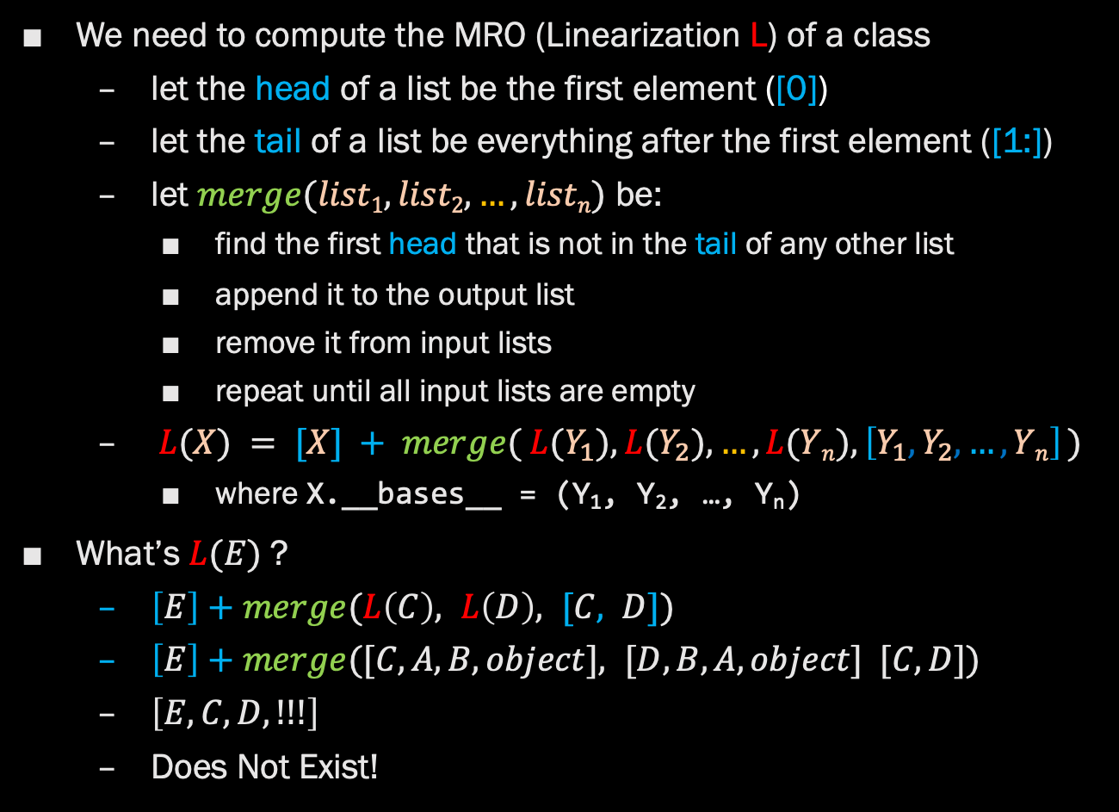
C3 Linearization
We need to compute the MRO (Linearization L) of a class
let the head of a list be the first element ([0])
let the tail of a list be everything after the first element ([1:])
let $merge(list1, list2, …, listn)$ be:
find the first head that is not in the tail of any other list
append it to the output list
remove it from input lists
repeat until all input lists are empty
$L(X) = [X] + merge( L(Y_{1}), L(Y_{2}), …, L(Yn), \left[Y_{1},Y_{2}, …, Yn\right] )$
where X.__bases__ = (Y₁, Y₂, …, Y_{n})
What’s $L(E)$?
$\left[E\right]+merge(L\left(C\right), L\left(D\right), [C, D])$
$\left[E\right]+merge([C,A,B, object], [D,B,A, object] [C, D])$
$\left[E, C, D, !!!\right]$
Does Not Exist!

Slide 18
C3 Linearization -> The MRO
Sometimes it is not possible to compute the merge function
The inheritance is too ambiguous
If you try this example, you will get:
… # all the other class declarations
>>> class E(C, D):
... pass
...
Traceback (most recent call last):
File "<stdin>", line 1, in <module>
TypeError: Cannot create a consistent method resolution
order (MRO) for bases A, B
C3 Linearization produces the MRO
But C3 fails, so there is no MRO, so this doesn’t compile

Slide 19
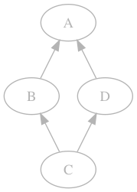
But What About super()?
>>> class A:
... def foo(self):
... print('A')
>>> class B(A):
... def foo(self):
... super().foo()
>>> class D(A):
... def foo(self):
... print('D')
>>> class C(B, D):
... pass
>>> B().foo()
A
>>> C().foo()
D
It cant just mean “access the superclass”
Which one?
We should use the MRO
It actually means “next in the MRO”
But which MRO?
We can’t know
Who’s B’s super()?
A?
Keep this in mind
for the homework

Slide 20
Let’s Look at some Real Code

